Slide 1


Flexi Benefit Plan Details: FY 2014-15
Salary Structure
Tax planning
Retirement benefits
Payroll Team

Slide 2
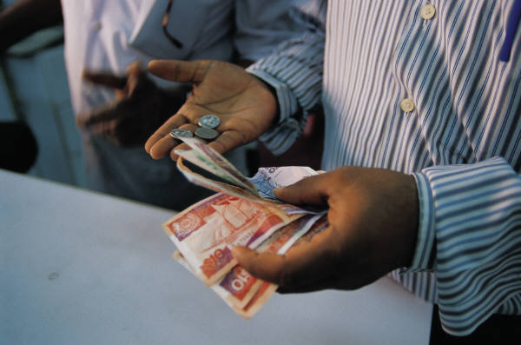
Salary Structure
  This Compensation plan provides you the flexibility to structure your salary from within a given choices
  It allows you to influence the design of your package in ways that suit your present and future needs
  Overall the salary is defined as:
    Base Salary
      Basic
      Flexi Compensation
    Allowances
      Benefits Allowance
      Superannuation Allowance
    Retirement Benefits
      PF
      Gratuity
    Variable Pay
  Base Salary is split into 2 major components:
    Basic Salary – 35%
    Flexible Compensation – 65%

Slide 3

Flexible Compensation – 65%
  Flexible Compensation makes up to 65% of your Base Salary
  This part comprises of the following components:
    House Rent Allowance (HRA)
    Medical Reimbursement
    Leave Travel Reimbursement (LTR)
    Children Education Allowance (CEA)
    Professional Development Allowance (PDA)
    Car lease allowance
    Fuel Reimbursement(Only for Racer Car lease Policy)
    Driver Salary(Both Racer & Company Car lease Policy)
    Telephone Reimbursement
    Transport allowance
    Special Allowance
  Employees can plan their salary structure based on the above listed components to suit their requirements
  The limits and tax benefits for each of the above components are listed in the following slides

Slide 4

House Rent Allowance - HRA
HRA
  This is one of the best tax saving options, provided the employee stays in a rented house.
  The tax benefit is calculated as least of the following:
    Actual HRA
    40% of Basic Salary
    Rent minus 10% of Basic Salary
  Recommended is to always keep this allowance at 40% of basic salary
  This will allow you to take the maximum benefit possible under HRA
  Note: Please note that the employees who are staying at Delhi can keep their HRA maximum up to 50% of their Basic.

Slide 5

Medical Reimbursement
Medical Reimbursement
  Medical Reimbursement will be paid to the maximum of 15000.00 INR per annum.
  The amount is paid against submission of original bills and Tax benefit is provided only to the extent of submitted original bills, incurred in the financial year.
  Bills can be for any medicines purchased, doctors fee, medical checkup, for you and your dependents.
  No hospitalization expenses are allowed under this category.
  For Spectacle bills, Power card or Doctor Prescription is required
  Un-claimed medical reimbursement amount will be paid to employee as a Taxable Allowance in March every year

Slide 6

Leave Travel Reimbursement
LTA
  Leave Travel Reimbursement will be paid to the maximum of 100,000 INR per annum
  Tax benefit will be given for 2 journeys in the block of 4 years, as per the Income Tax rules (the present block is Jan 2014 -Dec 2017)
  One journey is considered as one round trip, anywhere in India, starting from the place of your work
  Original Tickets have to be submitted to claim the tax benefit
  Only One Trip will be reimbursed in one financial year
  The amount is paid against submission of original bills and Tax benefit is provided only to the extent of submitted original bills, incurred in the financial year.
  Un-claimed leave travel reimbursement amount will be paid to employee as a Taxable Allowance in March every year

Slide 7

Professional Development Allowance - PDA
PDA
  Professional Development Allowance can be utilized for the following:
    To pay course fees for any further studies
    To buy books or CD’s
    To take up any memberships or certification courses
    All the above should be in line with your nature of Job and should be approved by your respective Manager
  The amount will be paid directly to the vendor or to the institution
  This amount is not shown in the employees income statement
  Any employee opted for PDA and not able to utilize the same, such amount will be paid back to the employee in March salary and fully taxed

Slide 8

Car lease Allowance
Car lease Allowance
  This component is applicable for employees who have availed a car under company car lease scheme (Existing Car Lease Policy and New Racer Policy)
  Employee portion of EMI amount will be parked under this component. Employee should not input any amount here since payroll will fill this in
  Employee will get a tax benefit for the amount mentioned under car lease allowance
  Employee will get petrol allowance based on their eligibility (this allowance will not be paid for those who have availed a car under racer policy)
  Perquisite on car is taxable

Slide 9
Fuel Reimbursement and Driver Salary
  Fuel Reimbursement : An amount of Rs.72,000/- per annum will be reimbursed
  When opted for this component, the amount is paid against submission of bills.
  The employee who is having the Racer Car Lease policy can only update in the Salary package
  The Unclaimed amount will be reimbursed in March payroll as Taxable Balance Payment.
  On Separation the Unclaimed amount will be paid as Taxable Balance Payment in the last month payroll
  Driver Salary: An amount of Rs.1,00,000/- per annum will be reimbursed
  When opted for this component, the amount is paid against submission of receipts.
  The employees under Car Lease policy can opt and update in the Salary package
  The Unclaimed amount will be reimbursed in March payroll as Taxable Balance Payment.
  On Separation the Unclaimed amount will be paid as Taxable Balance Payment in the last month payroll

Slide 10
Telephone Reimbursement
Telephone Expense Reimbursement
  An amount of Rs.24,000/- per annum will be reimbursed
  When opted for this component, the amount is paid against submission of bills
  Employee can claim this reimbursement for one Landline and one Mobile phone
  Employees have to submit original bills along with proof of payment
  Un-utilized amount will be paid back to the employee as “Taxable balance payment” at the end of the financial year
  In case of separation, un-utilized telephone reimbursement amount will be paid to you in your last month payroll
  This reimbursement facility (landline and mobile) is not available for those who have a Company provided Landline or Company Provided Mobile phone (including black berry, I Pad and I Phone)
  Mobile phone should be in the name of employee only
  Landline should be located in the city where the employee resides (basically where SAP offices are located)

Slide 11
Transport Allowance
Transport Allowance
    Eligible for those who commute on their own transport.
    Employees who use company shuttle services are not eligible.
    Employees who have availed the car under car lease scheme including racer policy are not eligible to claim this benefit
    Maximum eligibility and deduction is Rs 9600/- per annum for those who are eligible

Slide 12
Children Education Allowance
CEA
  Rs.100/- per child per month to a max of 2 children will be paid as Children Education Allowance
  Copies of the Fee receipts have to be submitted for claiming the tax benefit

Slide 13

Special Allowance
Special Allowance
  This is the balance amount out of your Flexible Compensation after allocating for other component
  This allowance is fully taxable

Slide 14
Retirement benefits
  Provident Fund
    Regional Provident Fund Commissioner, Bangalore ( RPFC, Bangalore )
    Transfer process
    RPFC to RPFC Yes
    Trust to RPFC Yes
  Superannuation allowance
    Employee has an option to select this allowance as part of their monthly salary or retirement benefit
    Part of monthly salary payouts does not have any additional tax benefit
    For retirement benefit there is a maximum cap Rs 1 Lac per annum
    Employees who opt for retirement benefit, will get additional tax benefit up to Rs 1 Lac per annum
  Gratuity benefit
    Employee who completes 2 years service with SAP Labs are eligible for this benefit
    Employee will get ½ month basic salary for every completed year of service
    Settlement amount up to Rs 10 Lakhs not taxable

Slide 15

Thank You!
E-mail – hrdirectapj@sap.com

